Slide 1
Welcome collaboration
Prof. Hiroya Kadokawa
hiroya@yamaguchi-u.ac.jp
http://ds.cc.yamaguchi-u.ac.jp/~hiroya/
Notes:
I would like to thank professor Terry Nett, and the committee of ICAR2022 for giving me this great opportunity to present our recent work.
I am vey sorry that I cannot attend this symposium because still my university prohibits travelling abroad.

Slide 2
Thank you very much for the important questions!

Slide 3
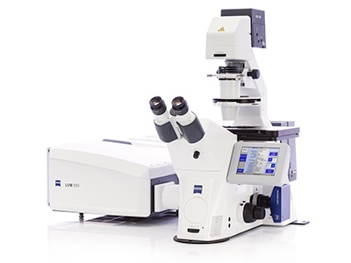
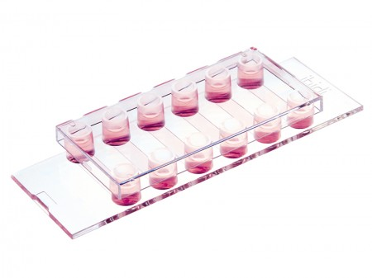
(1) Can you elaborate briefly on the “chamber slides” you used for the studies? How long was your culture period? Is this a fluidic (i.e. flow through) or static culture?

Slide 4
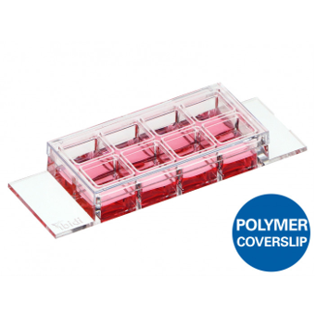
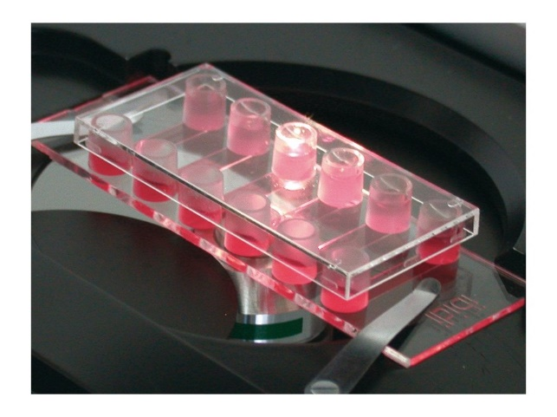
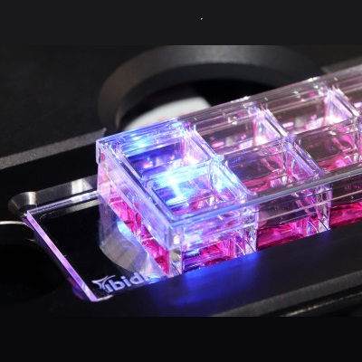
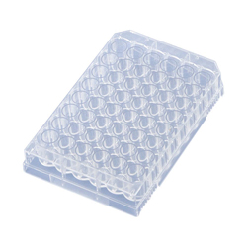
We used the chamber-slide (ibidi GmBH, Germany) to culture only in order to stain AP cells for easiness.
Alternative is microslide 8-well
For the test of AMH and EPls,
we used the 48-well or 24-well culture plates
for 3.5 days as static culture.
Notes:
We used the same antibodies for immunocytochemistry and confocal microscopy in the cultured anterior pituitary cells.

Slide 5
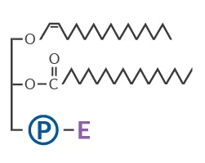
(2) Have you tested the functional role of your novel receptors in vivo? That is, will EP1s stimulated FSH secretion when administered to heifers?

Slide 6
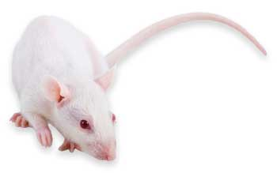
As for AMH, I will explain later for another question.
As for EPl, it is difficult to test in cattle in vivo.
It is because EPls are hydrophobic, and
we need to use organic solvent in first,
Then, we need to dilute further with medium.
Thus, in vivo study in cattle should be difficult.
Also our university prohibits to inject extracts from bovine brain to cattle for hygiene (e.g. BSE).
It may be possible to study in rats or mice,
although we cannot use the laboratory animals, and
we have no LH and FSH assays for them.
Therefore, we welcome any collaboration for in vivo study.

Slide 7
(3) Does the GnRH receptor antibody you produced work to localize GnRH receptors in other species?
We developed an original antibody to extracelluar region of bovine GnRH receptor

Slide 8
We have not tested the anti-bovine GnRHR antibody in other species, including sheep and goats, because they are rare animals in Japan.
The antigen sequece is extracellular region at N-terminal, amino acids 1–29, of bovine GnRHR
MANSDSPEQNENHCSAINSSIPLTPGSLP.
79% homology with human GnRHR
(NP_000397)
83% homology with pig GnRHR
(NP_999438)
90% homology with sheep GnRHR
(XP_012034748)
97% homology with goat GnRHR
(NP_001272541)
Therefore, we welcome any collaboration for other species.

Slide 9
(4) Will AMH induce GnRH secretion from cultured hypothalamus? If not what is its role in GnRH neurons?

Slide 10
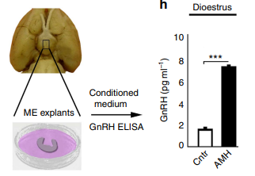
Yes, AMH stimulate GnRH neurons!
In vivo, AMH stimulate GnRH neurons in mouse
(Cimino et al. 2016, Nature Commun).
Neuron firing
GnRH secretion from ME explants
In vitro, AMH stimulate GnRH neuron cell models
(mHypoA-50 and mHypoA-55 cells)
(Oride et al. 2021, Gynecol Endocrinol.).

Slide 11
GnRH neurons are synthesizing GnRH, AMH, and AMHR2.
Preoptic
Area
3V
GnRH neurons
Arcuate
Nucleus
(AMH, AMHR2, and GnRH)
CB is cell body
V is varicosity
Cluster
Cluster
Cluster
Notes:
Then, we found that GnRH neurons are synthesizing both GnRH and AMH.

Slide 12
GnRH neurons are synthesizing GnRH, AMH, and AMHR2.
Preoptic
Area
3V
Our hypothesis is
paracrine and autocrine roles of AMH and AMHR2
in the GnRH neuron clusters in POA for the synchronization.
GnRH neurons
Arcuate
Nucleus
(AMH, AMHR2, and GnRH)
CB is cell body
V is varicosity
Cluster
Cluster
Cluster
Notes:
Then, we found that GnRH neurons are synthesizing both GnRH and AMH.

Slide 13
Thank you very much for the important questions!
Prof. Hiroya Kadokawa
hiroya@yamaguchi-u.ac.jp
http://ds.cc.yamaguchi-u.ac.jp/~hiroya/
Notes:
I would like to thank professor Terry Nett, and the committee of ICAR2022 for giving me this great opportunity to present our recent work.
I am vey sorry that I cannot attend this symposium because still my university prohibits travelling abroad.

